Slide 1

AIRBNB Hotel Booking Analysis
MOHAMMED MAAZ UDDIN
INTERNSHIP_172663295366ea53f910591

Slide 2

PROBLEM STATEMENT
Airbnb listings often show wide variations in pricing across neighborhoods, property types, and host characteristics. These inconsistencies make it difficult for hosts to set competitive yet profitable prices, while also creating uncertainty for guests about whether they are paying a fair rate.
The problem is to analyze how factors such as location, property type, host verification, reviews, and availability influence the price of Airbnb listings. By uncovering these patterns, the study will help identify pricing trends and provide data-driven recommendations for hosts to optimize their pricing strategy while ensuring affordability for guests

Slide 3
Project Description This project focuses on building a machine learning model to predict the price of Airbnb listings. Pricing an Airbnb property correctly is crucial for both hosts and travelers: hosts want to maximize occupancy and earnings, while travelers want fair and competitive prices. Using historical Airbnb data, the project develops a regression model that learns relationships between listing attributes (such as number of bedrooms, bathrooms, and guest ratings) and the price charged.

Slide 4

WHO ARE THE END USERS?
Airbnb Hosts:
To optimize pricing of their listings based on property features and guest reviews.
Travelers:
To evaluate whether a listing is overpriced or reasonably priced.
Airbnb Platform Analysts:
To improve automated pricing suggestions and increase platform trust
.Researchers/Students:
To study the impact of property features and reviews on rental pricing.

Slide 5

Technology Used
Python - Core programming language
Pandas & NumPy - Data cleaning and preprocessing
Scikit-learn - Machine learning (model training, regression, evaluation)
Matplotlib/Seaborn- Data visualization and feature importance
Google Colab - Cloud-based environment for running the project
File handling libraries - openpyxl (for Excel) and built-in CSV handling

Slide 6
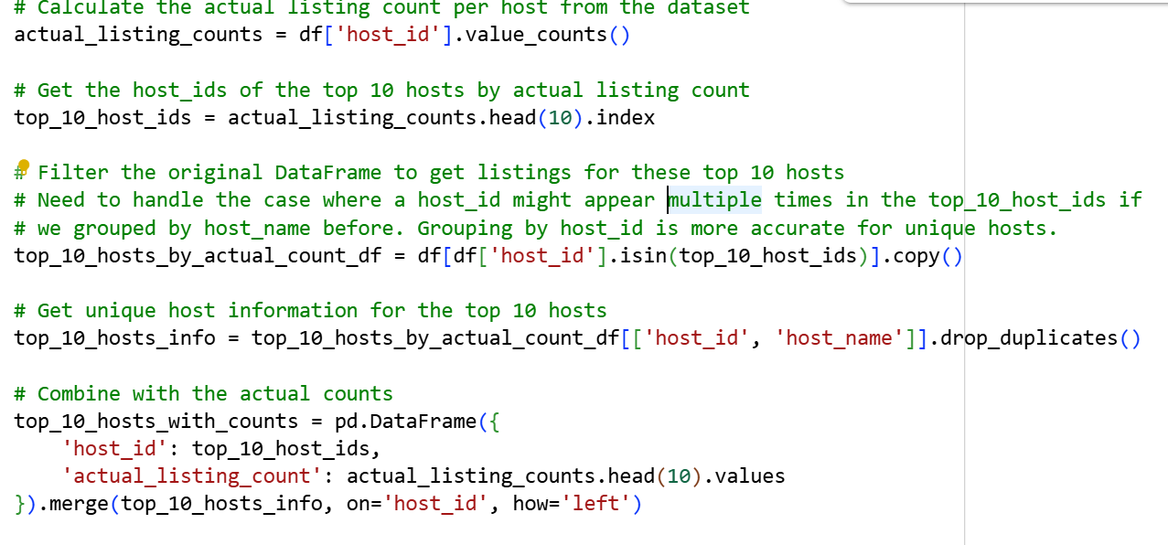
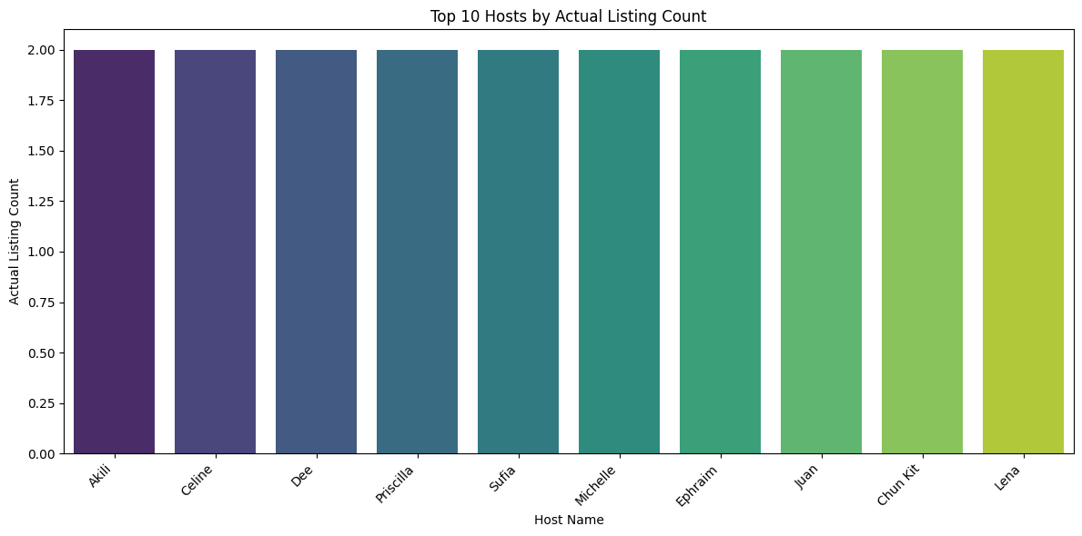
RESULT 1

Slide 7
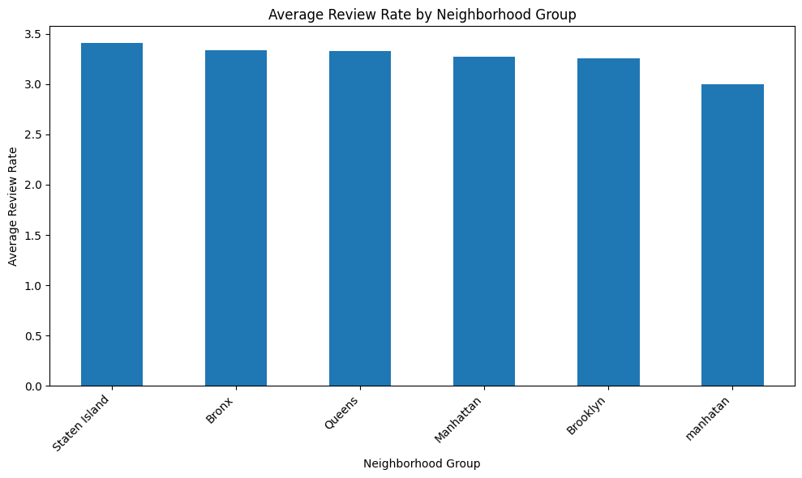
RESULT 2

Slide 8
GitHub repository
https://github.com/uddinmohammedmaaz-code/VOIS_AICTE_OCT2025_MOHAMMED-MAAZ-UDDIN.git

Slide 9
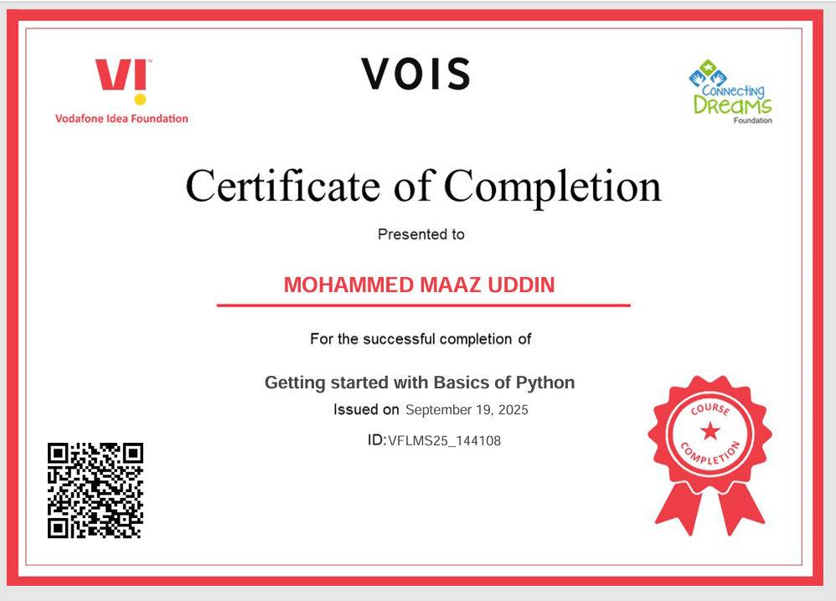
Getting started with Basics of Python Certificate:

Slide 10
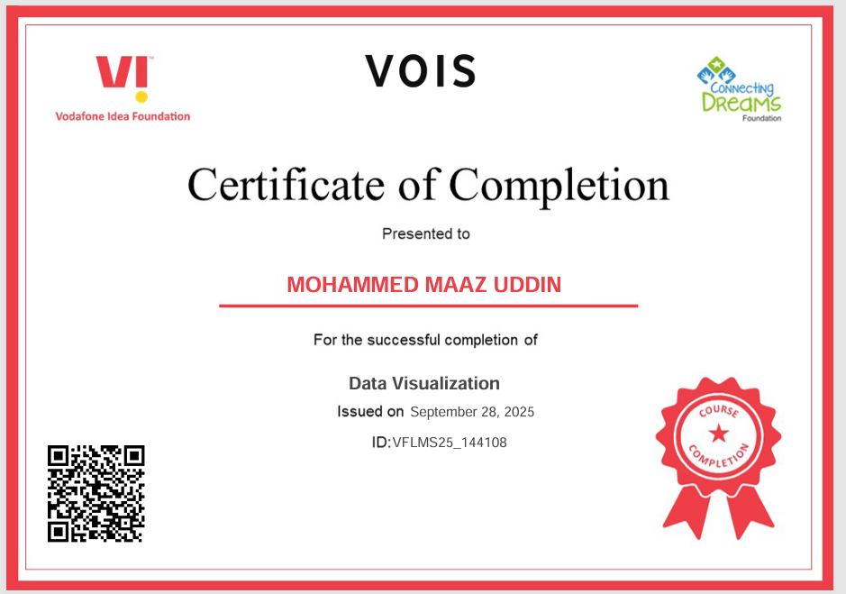
Data Visualization Certificate :

Slide 11
Thank you
.
.

